Slide 1

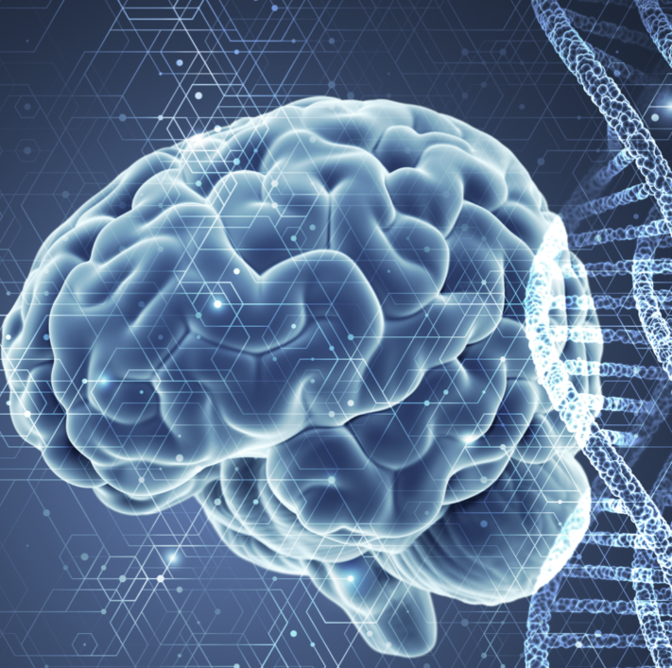
Gene expression data for brain region classification
Professor: Ana Fred
Supervisor: Sofia Agostinho
Discipline: Machine Learning for Bioengineering
P1, 2023/2024
Inês Brites nº 96120 Inês Marques nº 99674
Sofia Rebola nº 95973 Tomás Talento nº 99720

Slide 2
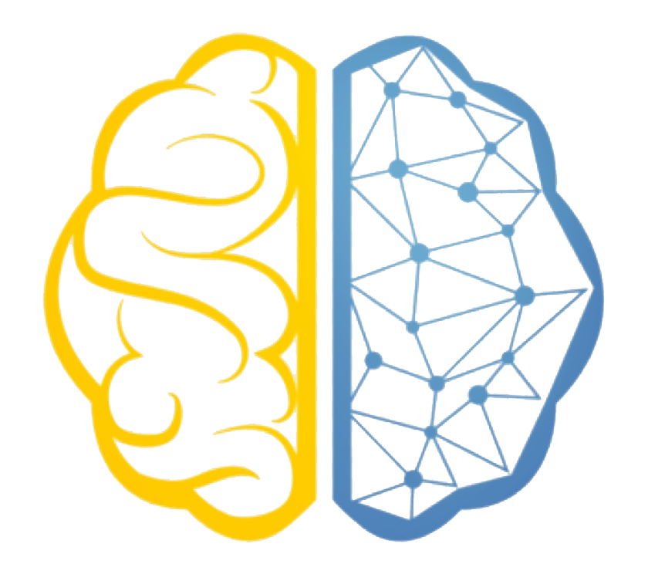
What we'll cover today:
Index
1. The motivation behind our study
2. Our proposed solution
3. General scheme of our approach
4. Method's Results and Discussion
5. Final Conclusions and Future Work
Sample Clustering
Gene Clustering

Slide 3
Introduction
Motivations
Connection between Brain Development and Psychiatric Disorders
Genetic Expression Variation in Psychiatric Disorders
Relevance of Treatment Personalization
Machine Learning as a Promising Approach
Connection between Brain Development and
Psychiatric Disorders
Genetic Expression Variation in Psychiatric Disorders
Relevance of Treatment Personalization
Machine Learning as a Promising Approach

Slide 4
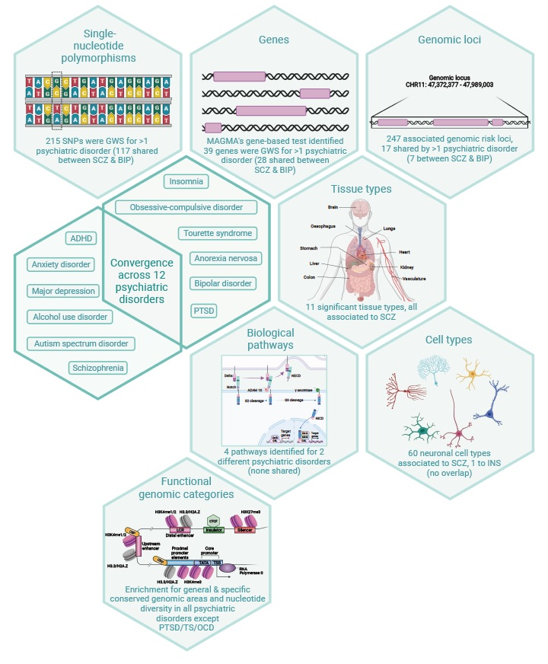
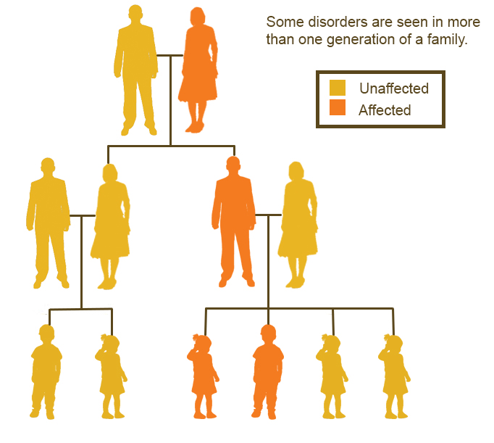
Introduction
Motivation – Genetics in Mental Diseases
Notes:
Mental diseases have long perplexed the scientific community and impacted countless lives worldwide. Autism, attention deficit hyperactivity disorder (ADHD), bipolar disorder, major depression, and schizophrenia are among the most challenging psychiatric disorders, known for their complexity and often devastating effects. One critical avenue of research into these conditions has been the exploration of their genetic underpinnings.
Recent studies have revealed a compelling insight into the genetic component of these disorders. There is growing evidence that they share certain genetic factors, suggesting a complex interplay between genes and the development of these conditions. Family histories of these disorders further underscore a potential genetic basis. Researchers have turned to cutting-edge genome-wide association studies (GWAS) to unravel the genetic markers that underlie these conditions, and this is where clustering techniques come into play.

Slide 5
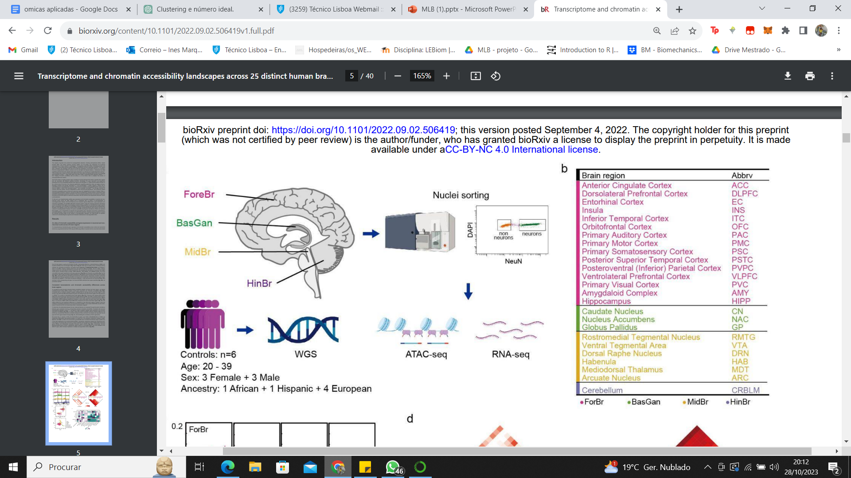
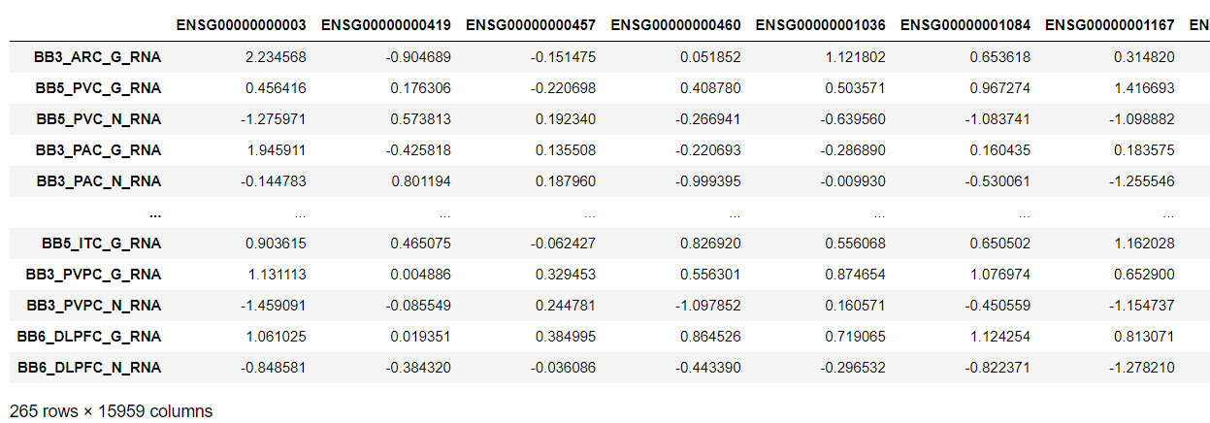
Introduction
Data Set and Brain Regions
Gene Set
Sample Set
Individual's Label
_N_- Neurons
_G_- Glial cells

Slide 6
Introduction
Part I
Part II
Part III
K-Means
K-Means
Samples Clustering
HC
HC
K-Means
K-Means
K-Means
Samples Clustering with PCA
HC
HC
HC
PCA with all the genes
Elbow Method
K-Means
Expression Heatmaps
Genes Clustering
PCA with only Neurons
Gene Ontology

Slide 7

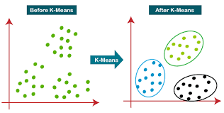
K-Means
Methods
&
Tests
K-Means
1
Goal:
Randomly selects K centroids of the sample points.
Minimize the sum of distances between the data points and the cluster centroid attributing a data point to a cluster based on similarity.
2
Each cluster is initialized by computing its centroid.
3
Assign the closest centroid to each sample.
Centroids are then moved to the center of the samples that were assigned to it
4

Slide 8
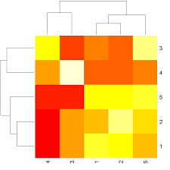
Hierarchical bi-clustering heatmaps (Expression Heatmaps)
Methods
&
Tests
Implementation:
Expression heatmaps
Clustermap's function to visualize
Use of Seaborn library
Goal:
exploring complex datasets and identifying subsets of rows and columns that exhibit similar behavior.
Combinatition of methods
Combine Hierarchical Clustering and Bi-clustering
Advantages:
Clear Visual Interpretation
Clear representation of similarities and dissimilarities.
Uncover underlying patterns in noisy data, as it groups similar samples and features
Robust to Noise

Slide 9
Hierarchical clustering
Methods
&
Tests
Agglomerative Hierarchical Clustering
Tests done
Euclidean distance + Complete linkage
Euclidean distance + Single linkage
Correlation distance + Complete linkage
Correlation distance + Single linkage
Starts with the single-object clusters and successively joints the closest clusters until obtaining a unique cluster containing all the objects [1]
Need to define
Distance between objects
Distance between clusters

Slide 10
Methods
&
Tests
Part I
Part II
Part III
K-Means
K-Means
Samples Clustering
HC
HC
K-Means
K-Means
K-Means
Samples Clustering with PCA
HC
HC
HC
PCA with all the genes
Elbow Method
K-Means
Expression Heatmaps
Genes Clustering
PCA with only Neurons
Gene Ontology

Slide 11
Samples clustering
Methods
&
Tests
Two-phase approach
Part I
Part II
N = 2
Hypothesis: are cells from neurons and glia distinguishable?
N = 4
Hypothesis: are cells from the four cerebral regions distinguishable?
K-means
HC
K-means
HC

Slide 12
Samples clustering
Methods
&
Tests
Two-phase approach
Part I
Part II
N = 2
Hypothesis: are cells from neurons and glia distinguishable?
N = 4
Hypothesis: are cells from the four cerebral regions distinguishable?
K-means
HC
K-means
HC

Slide 13
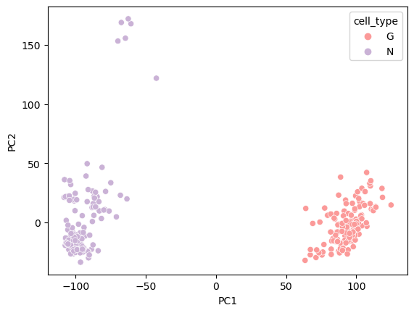
K-means
Results
&
Discussion
Results analysis
K-Means successfully clustered the samples by neurons and glia cells.
These results support the idea that we can destinguish glia cells and neurons, based on transcript data.
True labels
Glia
Neurons
Silhouette score: 0. 444
Rand-index score: 1.0
Notes:
Métodos + testes (Tomás)

Slide 14
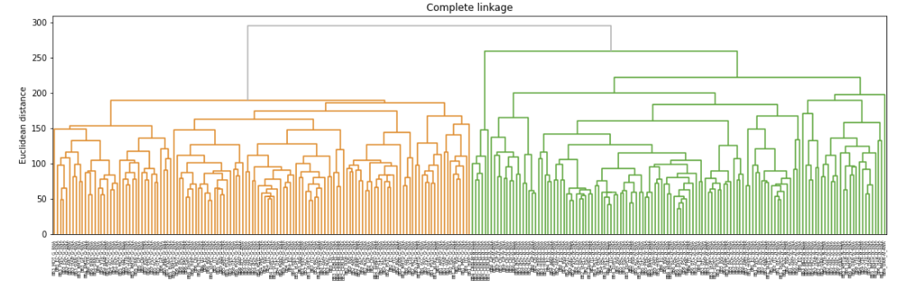
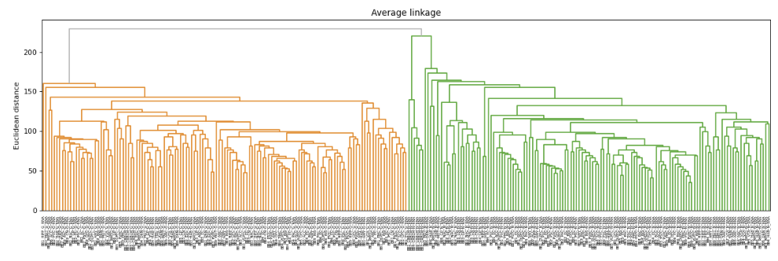
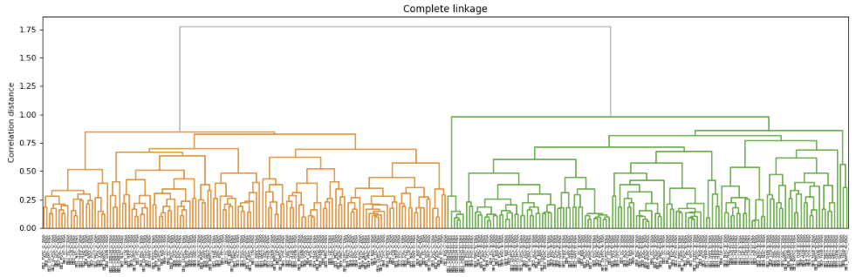
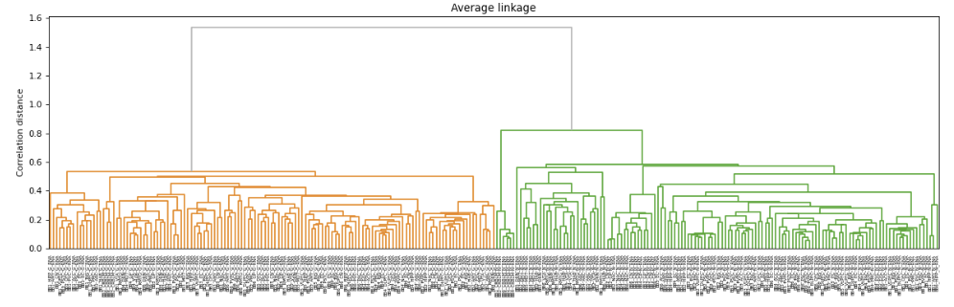
Hierarchical clustering
Results
&
Discussion
Results analysis
Independently of the metrics used we are always able to obtain the same two clusters (Glia vs Neurons)
We are not still able to choose a single test as the best one, as they produce all the same results
The silhuoette score and rand index score were computed and are the same for all the tests
These results support the idea that we can destinguish glia vs neurons, based on their biological differences
True labels
Glia
Neurons
Silhouette score: 0. 4440158094773555
Rand-index score: 1.0
Notes:
Métodos + testes (Tomás)

Slide 15
Samples clustering
Methods
&
Tests
Two-phase approach
Part I
Part II
K = 2
Hypothesis: are cells from neurons and glia distinguishable?
K = 4
Hypothesis: are cells from the four cerebral regions distinguishable?
K-means
HC
K-means
HC
Notes:
Métodos + testes (Tomás)

Slide 16
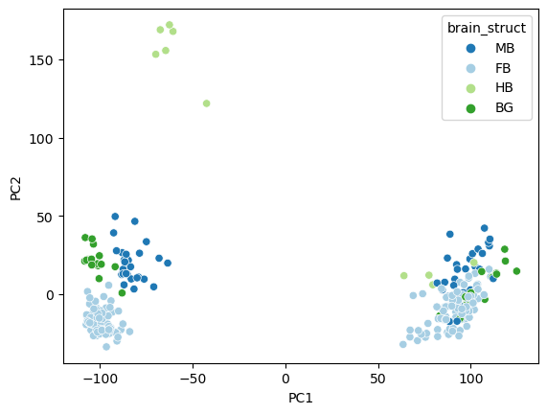
K-means
Results
&
Discussion
Results analysis
The cell type variability is greater than the between regions variability.
The structure of the data does not allow clustering of the samples by region.
Possible solution: consider only the neuron samples.
True labels
HB
BG
FB
MB
Silhouette score: 0.236
Rand-index score: 0.065
Notes:
Métodos + testes (Tomás)

Slide 17
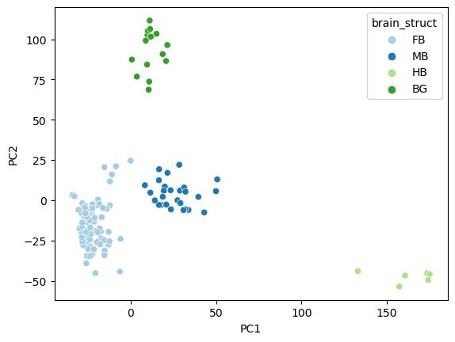
K-means
Results
&
Discussion
Results analysis
By considering only the neuron samples it was possible to distinguish between brain regions.
Hindbrain samples are the most different from the other regions.
True labels
HB
BG
FB
MB
Silhouette score: 0.254
Rand-index score: 1.0
Notes:
Métodos + testes (Tomás)

Slide 18
Methods
&
Tests
Part I
Part II
Part III
K-Means
K-Means
Samples Clustering
HC
HC
K-Means
K-Means
K-Means
Samples Clustering with PCA
HC
HC
HC
PCA with all the genes
Elbow Method
K-Means
Expression Heatmaps
Genes Clustering
PCA with only Neurons
Gene Ontology

Slide 19
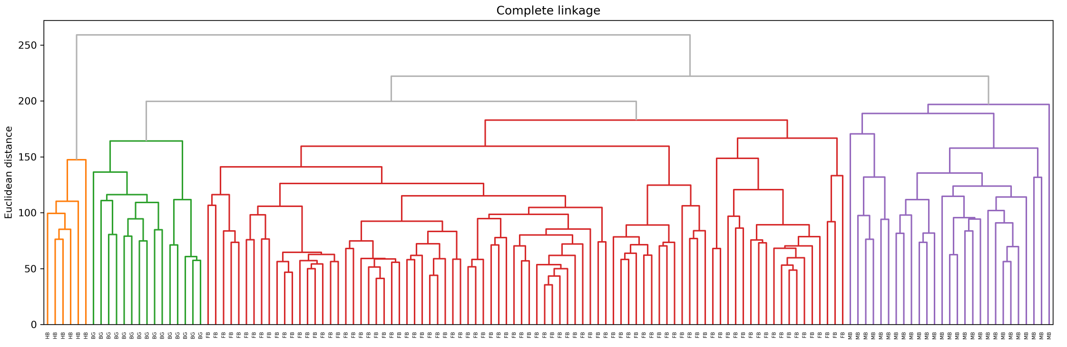
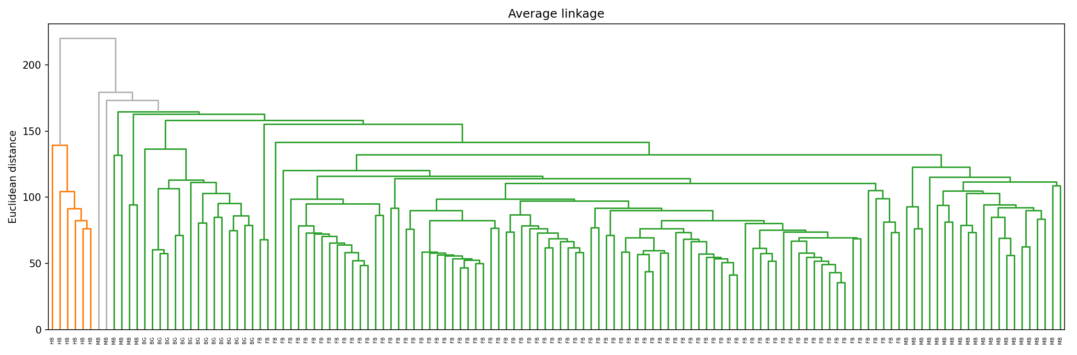
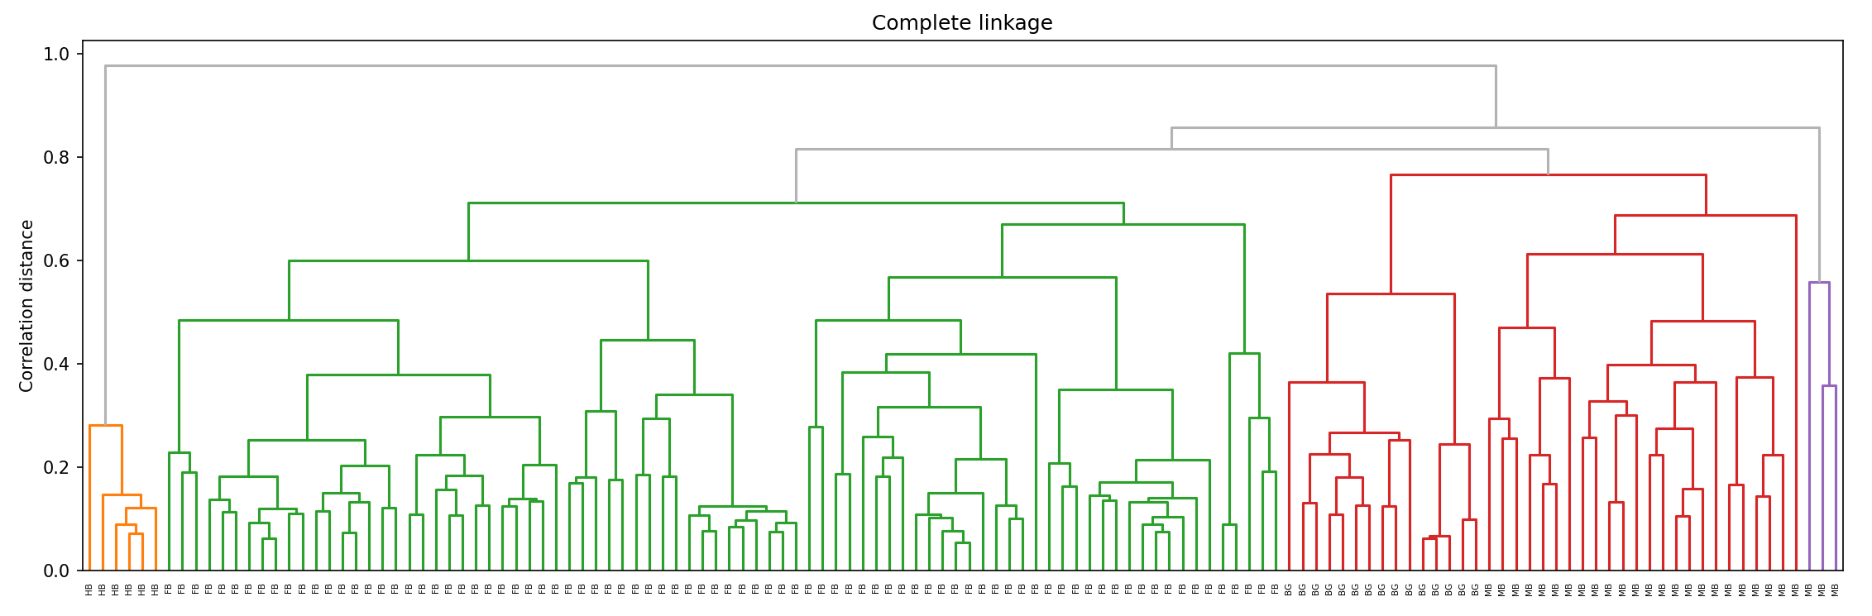
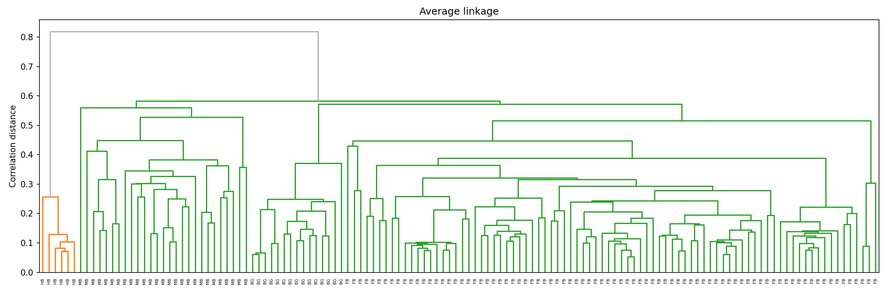
Hierarchical clustering
Results
&
Discussion
Silhouette score: 0.25410455166431134
Rand-index score: 1.0
Silhouette score: 0.26360112823288123
Rand-index score: 0.17765609589886647
Silhouette score: 0.21811340188890257
Rand-index score: 0.899916510274156
Silhouette score: 0.21811340188890257
Rand-index score: 0.899916510274156
True labels
HB
BG
FB
MB
Notes:
Métodos + testes (Tomás)

Slide 20
Hierarchical clustering
Results
&
Discussion
Best method
HB
BG
FB
MB
Euclidean distance + Complete linkage was the best method to distinguish the four brain regions
Notes:
Métodos + testes (Tomás)

Slide 21
Sample Clustering with PCA
Methods
&
Tests
PCA applied to HC
Part I
Part II
Part III
Using only the genes that result from PCA (with all samples: neurons and glia) to obtain two clusters
Using only the genes that result from PCA (with all samples: neurons and glia) to obtain four clusters
Using only the genes that result from PCA (with just the neurons) to obtain four clusters
K-Means
HC
K-Means
HC
K-Means
HC
Notes:
Métodos + testes (Tomás)

Slide 22
Sample Clustering with PCA
Methods
&
Tests
PCA applied to HC
Part I
Part II
Part III
Using only the genes that result from PCA (with all samples: neurons and glia) to obtain two clusters
Using only the genes that result from PCA (with all samples: neurons and glia) to obtain four clusters
Using only the genes that result from PCA (with just the neurons) to obtain four clusters
K-Means
HC
K-Means
HC
K-Means
HC
Notes:
Métodos + testes (Tomás)

Slide 23
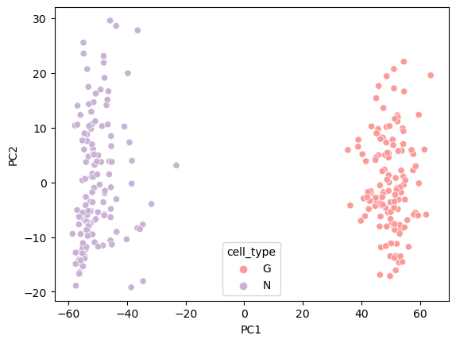
K-means
Results
&
Discussion
Are we able to decrease the problem complexity by using only the genes that result from PCA (with all samples: neurons and glia) to obtain two clusters?
15959 genes
Silhouette score: : 0. 444
Rand-index score: 1.0
1000 genes
Silhouette score: 0.694
Rand-index score: 1.0
True labels
Glia
Neurons
K-Means was still able to cluster neuron and glia samples with fewer genes.
Notes:
Métodos + testes (Tomás)

Slide 24
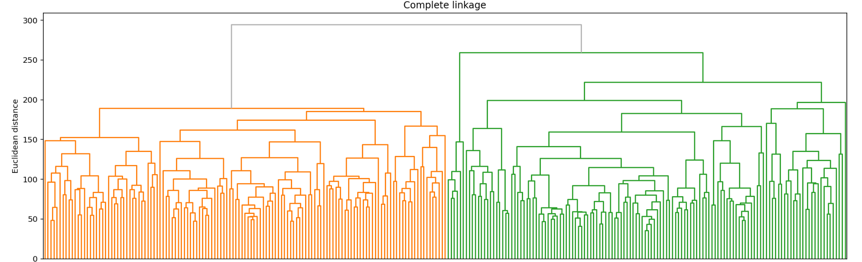
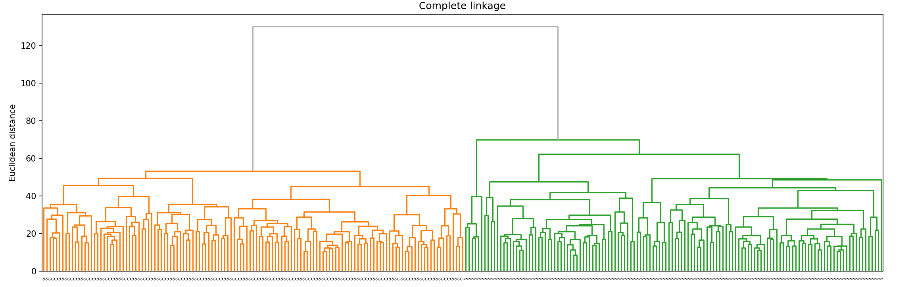
Hierarchical clustering
Results
&
Discussion
Are we able to decrease the problem complexity by using only the genes that result from PCA (with all samples: neurons and glia) to obtain two clusters?
15959 genes
1000 genes
Silhouette score: : 0. 4440158094773555 Rand-index score: 1.0
Silhouette score: 0.6936420448994739
Rand-index score: 1.0
Yes and with an improvement in the Silhuoette score
True labels
Glia
Neurons
Notes:
Métodos + testes (Tomás)

Slide 25
Sample Clustering with PCA
Methods
&
Tests
PCA applied to HC
Part I
Part II
Part III
Using only the genes that result from PCA (with all samples: neurons and glia) to obtain two clusters
Using only the genes that result from PCA (with all samples: neurons and glia) to obtain four clusters
Using only the genes that result from PCA (with just the neurons) to obtain four clusters
K-Means
HC
K-Means
HC
K-Means
HC
Notes:
Métodos + testes (Tomás)

Slide 26
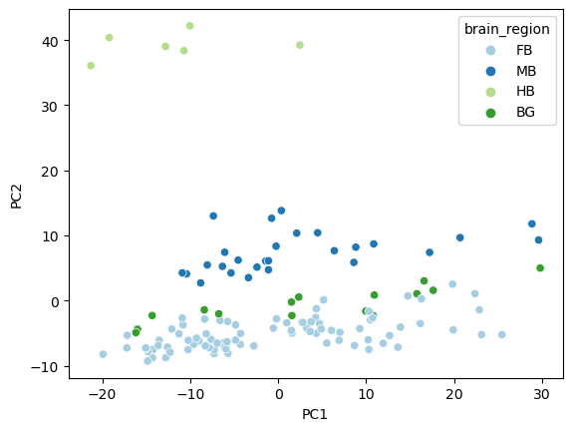
K-means
Results
&
Discussion
Are we able to decrease the problem complexity by using only the genes that result from PCA (with all samples: neurons and glia) to obtain four clusters?
15959 genes
Silhouette score: 0.254
Rand-index score: 1.0
1000 genes
Silhouette score: 0.129
Rand-index score: 0.324
True labels
HB
BG
FB
MB
PCA is capturing the genes explaining the highest data variance, which correspond to genes with information on the cell type and not on the brain region.
Notes:
Métodos + testes (Tomás)

Slide 27
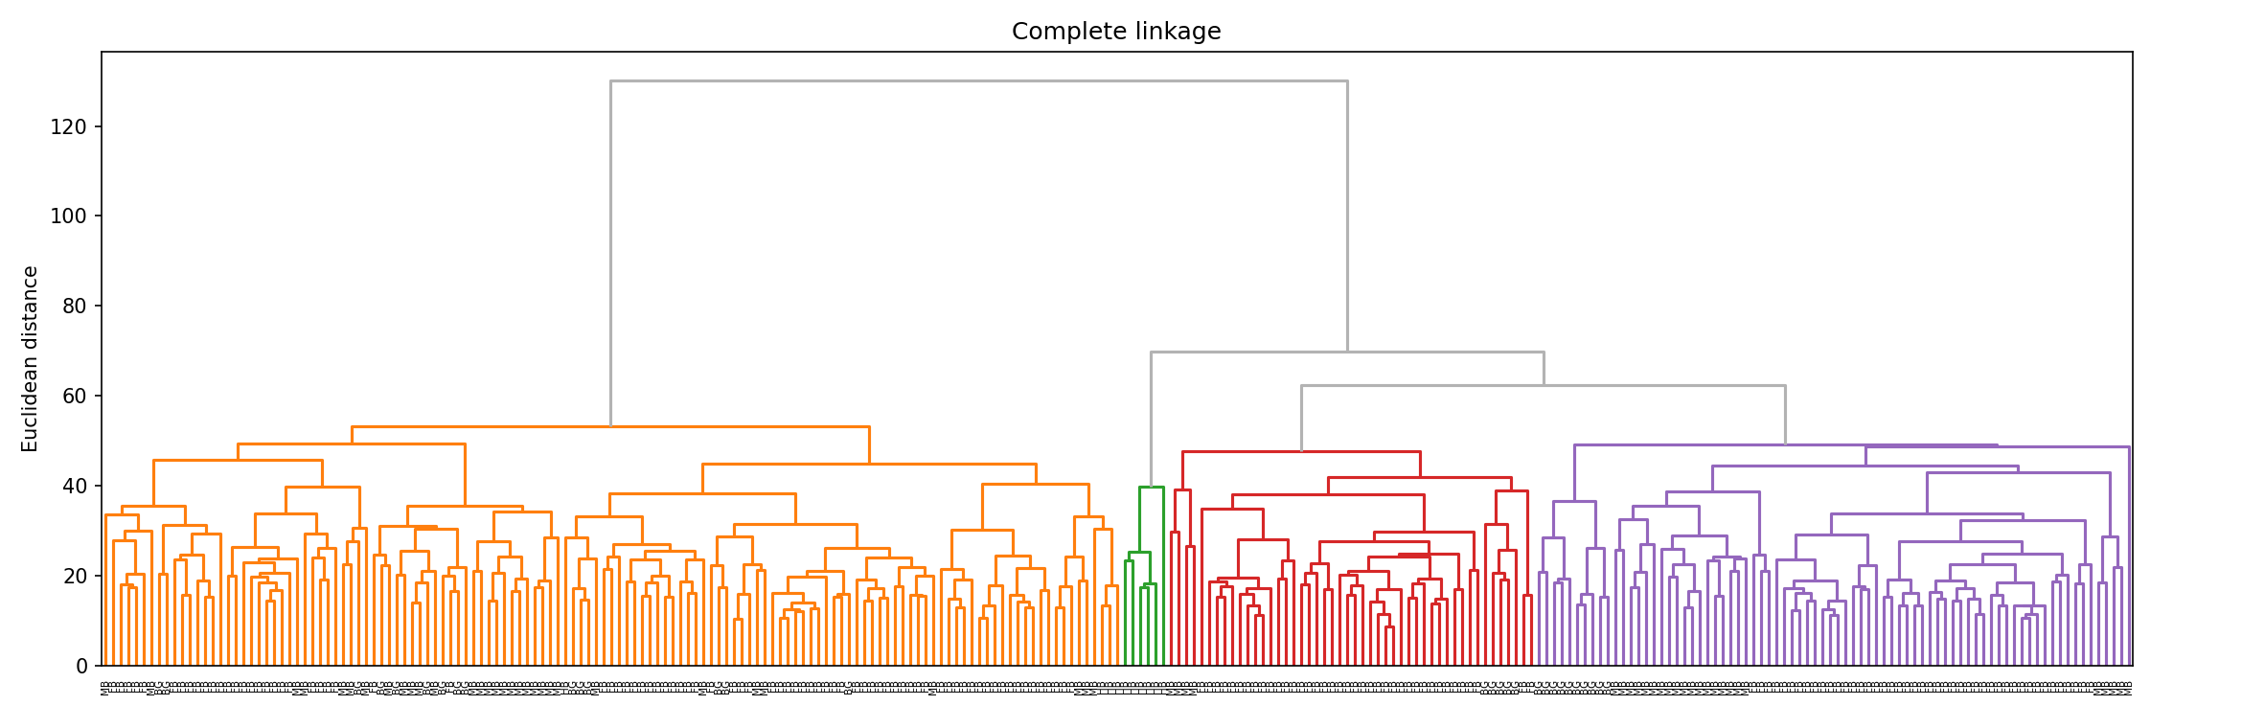
Hierarchical clustering
Results
&
Discussion
Are we able to decrease the problem complexity by using only the genes that result from PCA (with all samples: neurons and glia) to obtain four clusters?
15959 genes
1000 genes
Silhouette score: 0.25410455166431134
Rand-index score: 1.0
Silhouette score: 0.3239831495665883
Rand-index score: 0.013897877659627272
No (results got worse)
Probably because we are using genes that are relevant to distinguish neurons and glia
True labels
HB
BG
FB
MB
Notes:
Métodos + testes (Tomás)

Slide 28
Sample Clustering with PCA
Methods
&
Tests
PCA applied to HC
Part I
Part II
Part III
Using only the genes that result from PCA (with all samples: neurons and glia) to obtain two clusters
Using only the genes that result from PCA (with all samples: neurons and glia) to obtain four clusters
Using only the genes that result from PCA (with just the neurons) to obtain four clusters
K-Means
HC
K-Means
HC
K-Means
HC
Notes:
Métodos + testes (Tomás)

Slide 29
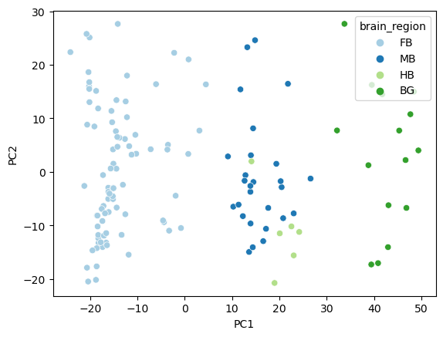
K-means
Results
&
Discussion
Are we able to decrease the problem complexity by using only the genes that result from PCA (with just neurons) to obtain four clusters?
15959 genes
Silhouette score: 0.254
Rand-index score: 1.0
1000 genes
Silhouette score: 0. 240
Rand-index score: 0.541
True labels
HB
BG
FB
MB
The top 1000 genes captured by PCA on the neuron samples did not enable a good clustering of the neuron samples by brain region with K-Means. More information/genes would be needed.
Notes:
Métodos + testes (Tomás)

Slide 30
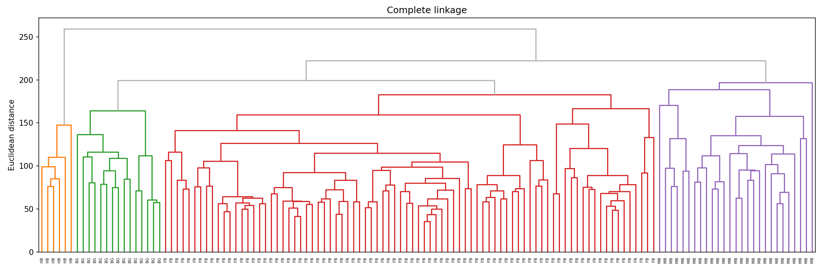
Hierarchical clustering
Results
&
Discussion
Are we able to decrease the problem complexity by using only the genes that result from PCA (with just neurons) to obtain four clusters?
15959 genes
1000 genes
Silhouette score: 0.25410455166431134
Rand-index score: 1.0
Silhouette score: 0.25410455166431134
Rand-index score: 1.0
Yes and we obtained exactly the same results
True labels
HB
BG
FB
MB
Notes:
Métodos + testes (Tomás)

Slide 31
Methods
&
Tests
Part I
Part II
Part III
K-Means
K-Means
Samples Clustering
HC
HC
K-Means
K-Means
K-Means
Samples Clustering with PCA
HC
HC
HC
PCA with all the genes
Elbow Method
K-Means
Expression Heatmaps
Genes Clustering
PCA with only Neurons
Hierarchical Bi-Clustering Heatmaps
Hierarchical Bi-Clustering Heatmaps
Gene Ontology

Slide 32
Genes Clustering
Methods
&
Tests
PCA Total
Explained Variance Rate
Loadings of Genes
Choice of 500 genes for each PC
K-means
Choice of K
Elbow Method
Expression Heatmaps
Gene Ontology

Slide 33
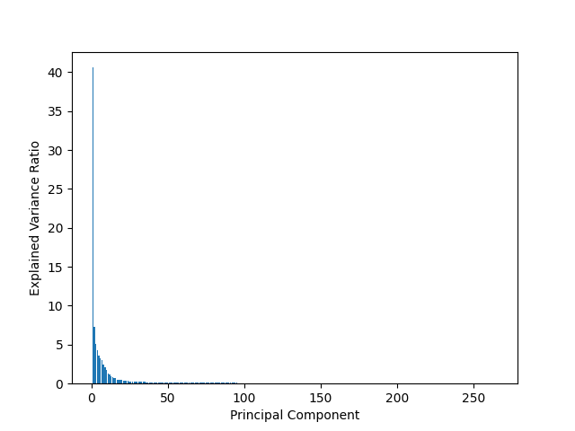
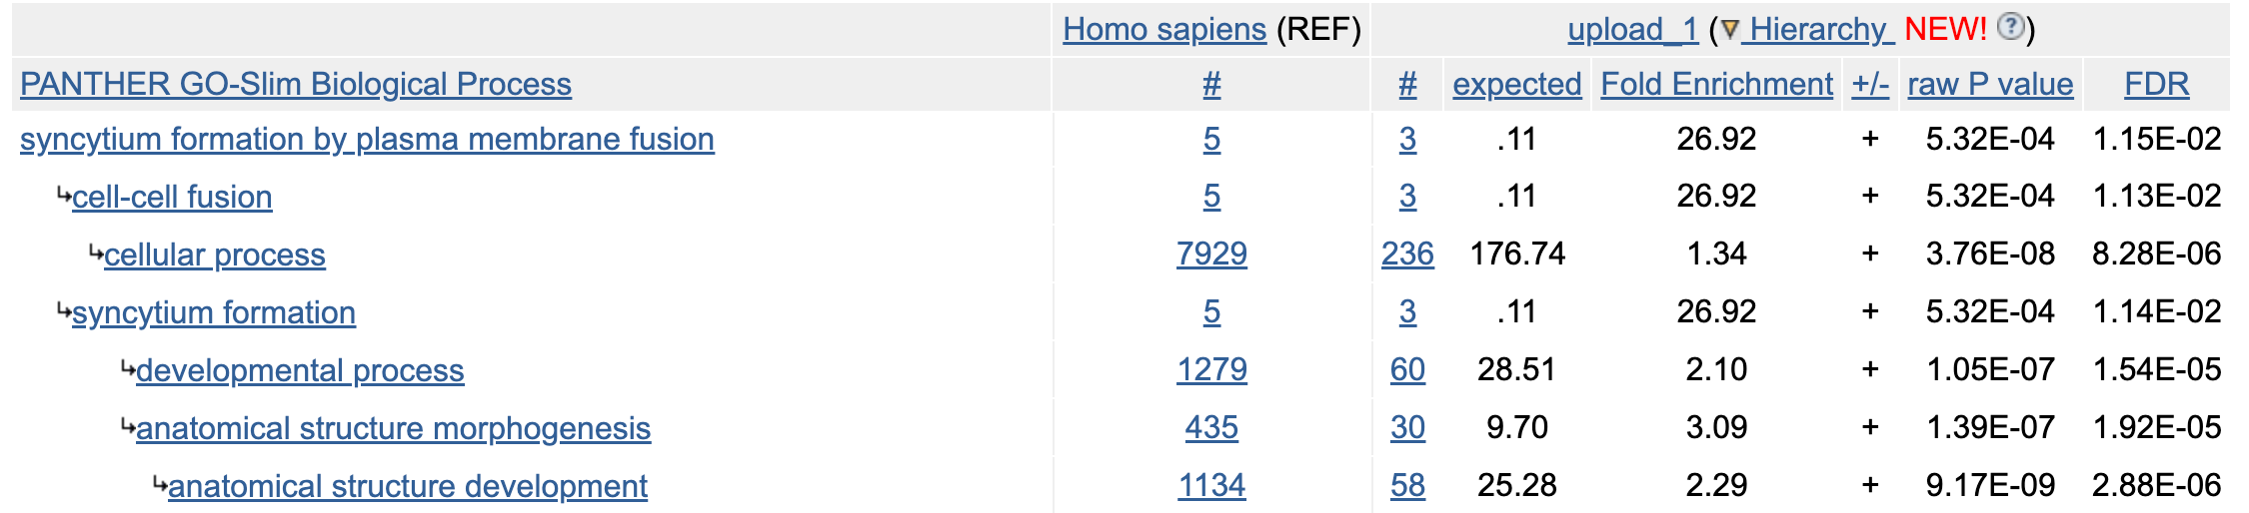
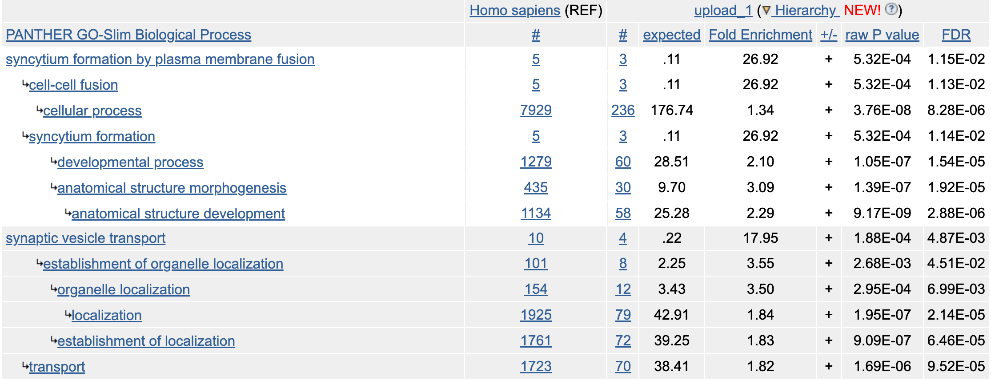


PCA: Explained Variance Rate
Results
&
Discussion
Gene Ontology
For PC1:
For PC2:
PC1 and PC2 explain approximately 50% of the variance.
No specific biological functions were obtained.
Notes:
Dúvida: É relevante mencionar que ao nível do pc2 foram obtidas mais funções biológicas do que no pc1? Tanto no PC1 como no PC2 apenas obtive funções biológicas mais gerais.

Slide 34
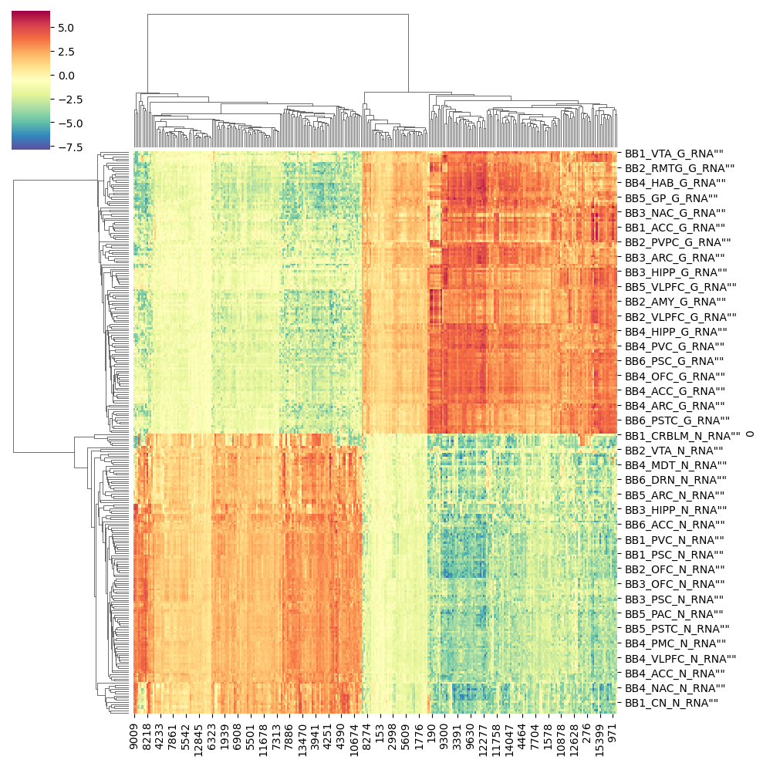
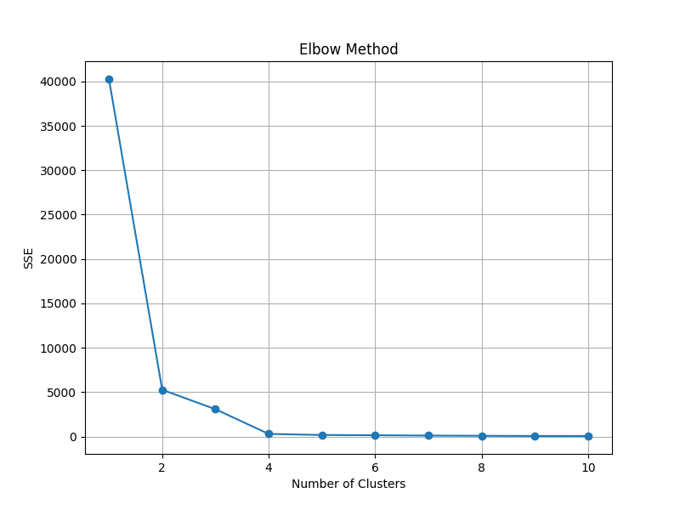
Elbow Method and Expression heatmaps
Results
&
Discussion
Kmean=Kmeans (n_clusters=4, random_state=42, n_init=10)

Slide 35
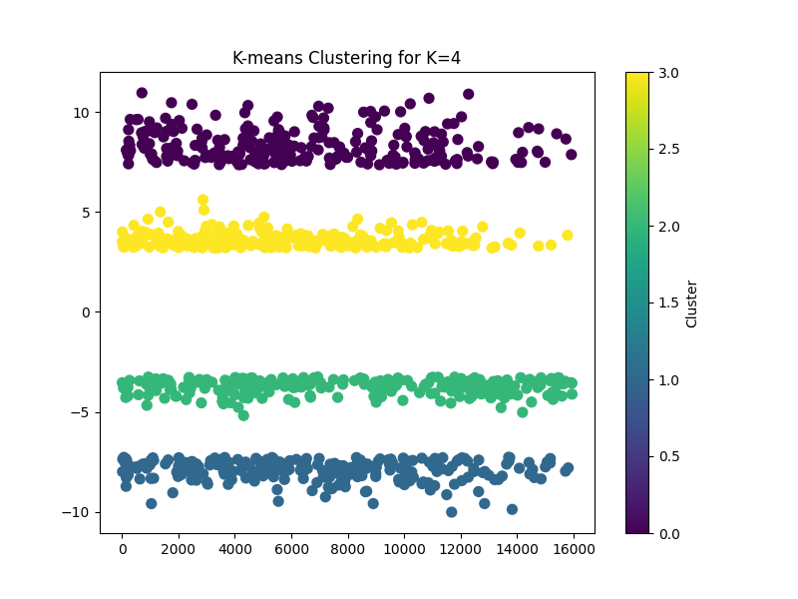
K-Means
Results
&
Discussion
Kmean=Kmeans (n_clusters=4, random_state=42, n_init=10)

Slide 36
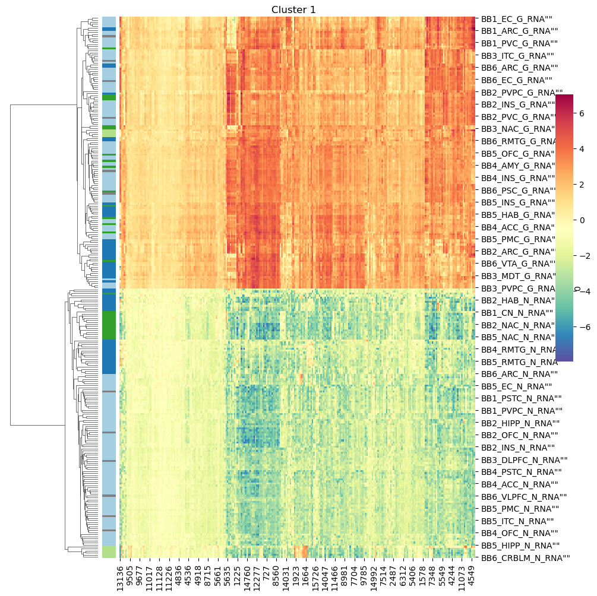
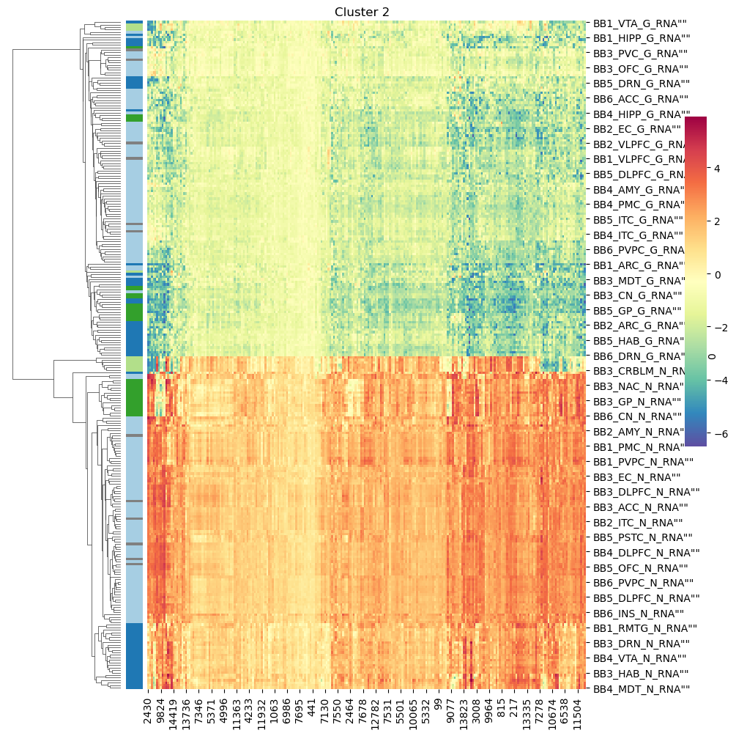
Expression heatmaps for K=4 (Cluster 1 and 2)
Results
&
Discussion
Notes:
Resultados Inês- o cluster 1 e 2 apresentam padrões de expressão opostos, sendo que o 1 apresenta elevada expressão para as amostras da glia e o cluster 2 para os neurónios.
Nos retangulos estão representadas as amostras de cerebelo que revelam ter uma expressão génica muito característica.

Slide 37
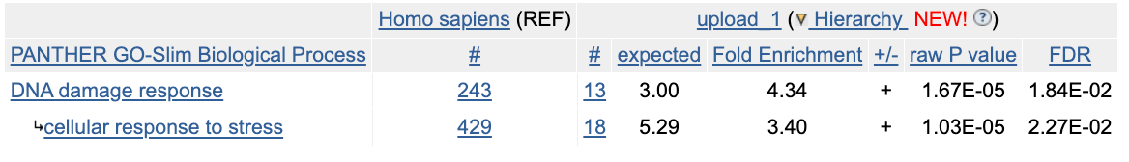
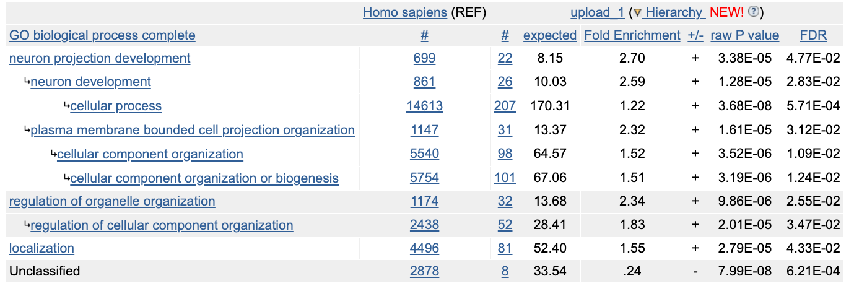

Gene Ontology
Results
&
Discussion
Cluster nº1
Cluster nº2
No specific biological functions were obtained.
Specific biological function obtained.
Biological process that encompasses the growth, maturation, and organization of structures extending from neurons, such as axons and dendrites.

Slide 38
K-Means
Results
&
Discussion
Kmean=Kmeans (n_clusters=4, random_state=42, n_init=10)

Slide 39
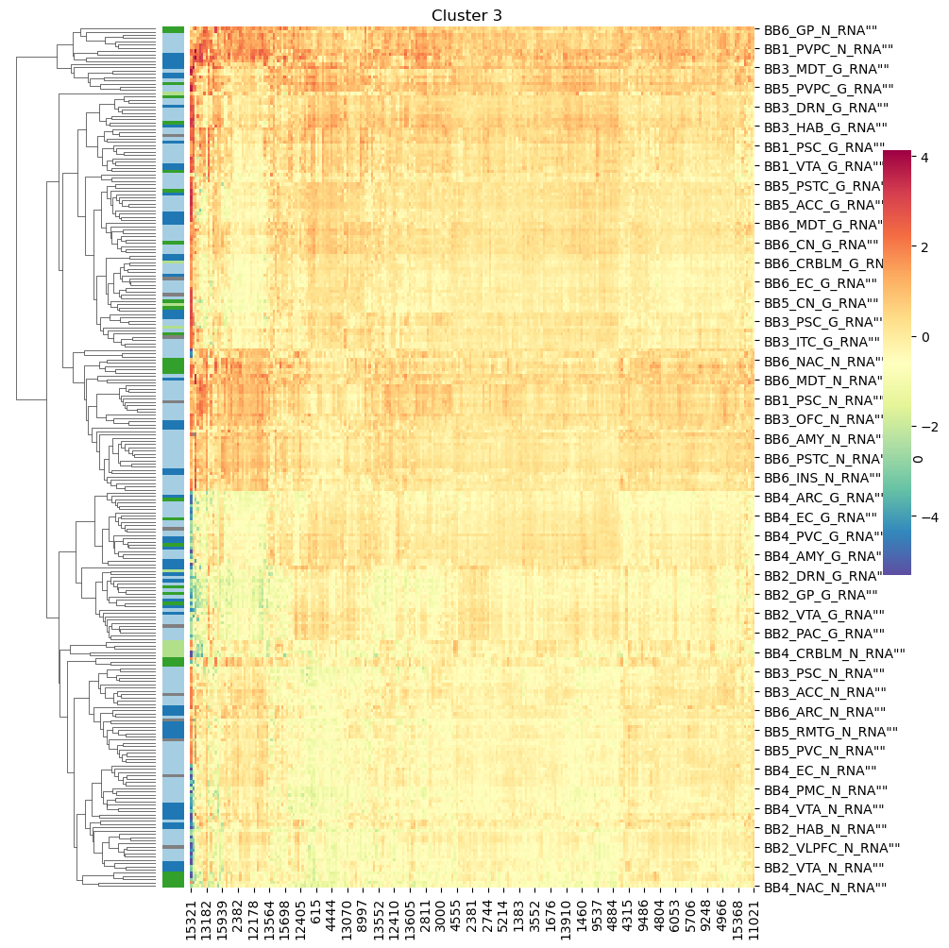
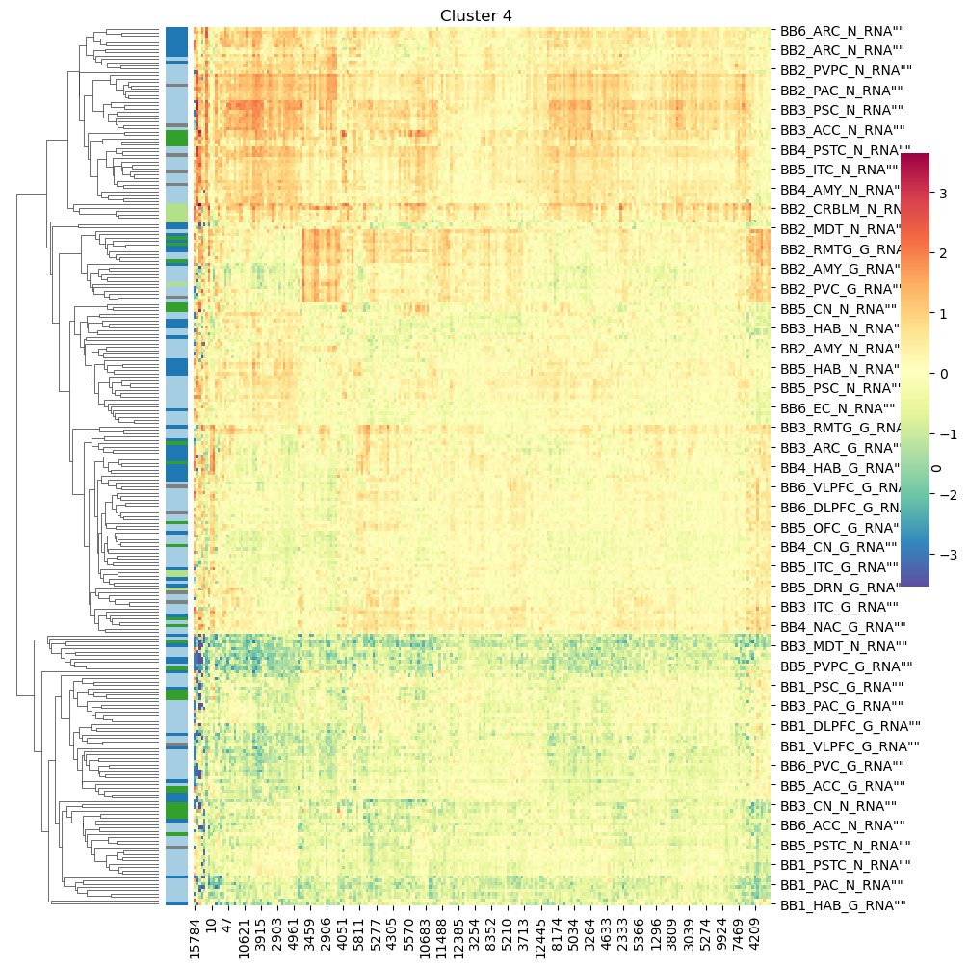
Expression heatmaps for K=4 (Cluster 3 e 4)
Results
&
Discussion
Notes:
Métodos mais testes para parte Inês-- O cluster 4 apresenta um padrão intermédio entre o 0 e o 1 e os genes com menos expressão são pas a região y.(ver qual a regiao
Já nem mostram expressão diferencial de genes entre neurónios e glia.
O cluster 3 apresenta-se como um cluster de genes com expressão media elevada para todas as amostras, contendo muito provavelmente genes característicos dos neurónios em geral.

Slide 40
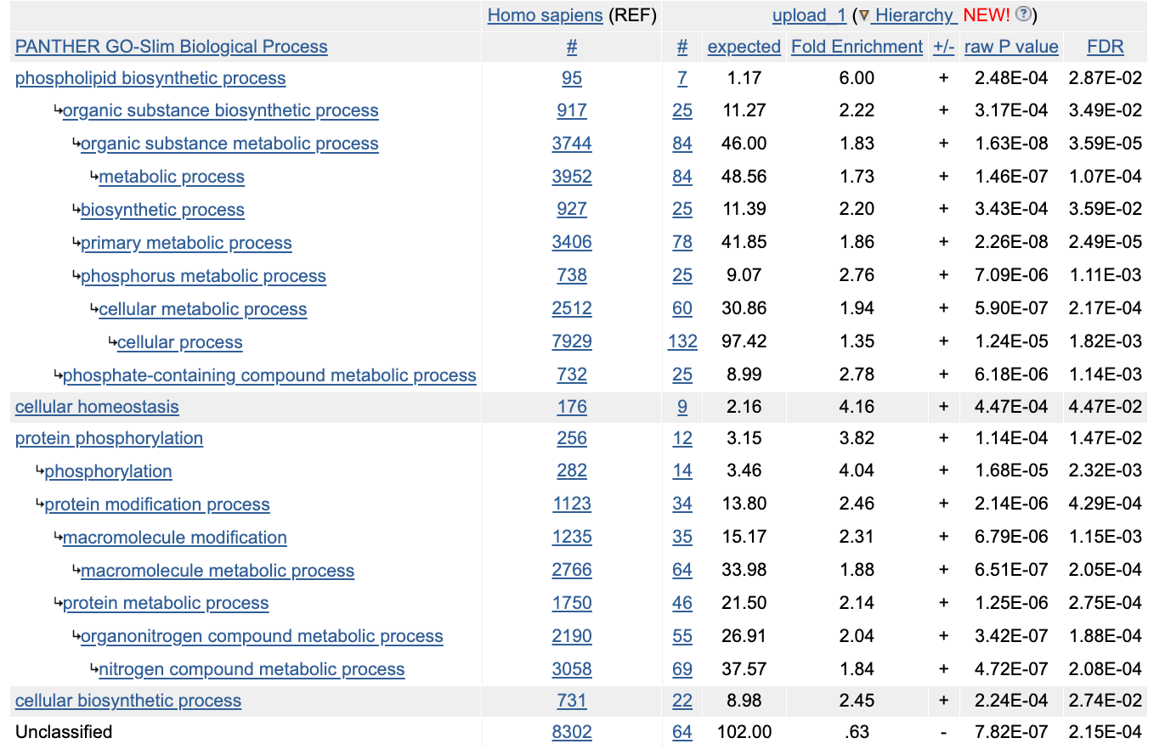
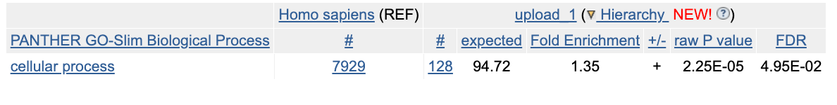
Gene Ontology
Results
&
Discussion
Cluster nº3
Cluster nº4
No specific biological functions were obtained.
Notes:
Dúvida: Faz sentido deixar este slide visto não ser possível retirar nenhuma conclusão?

Slide 41
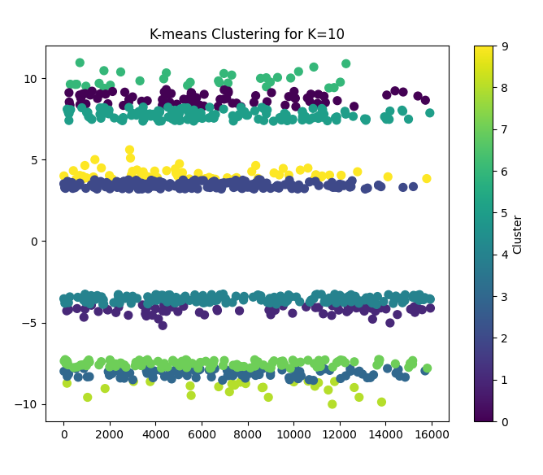
K-Means
Results
&
Discussion
Kmean=Kmeans (n_clusters=10, random_state=42, n_init=10)

Slide 42
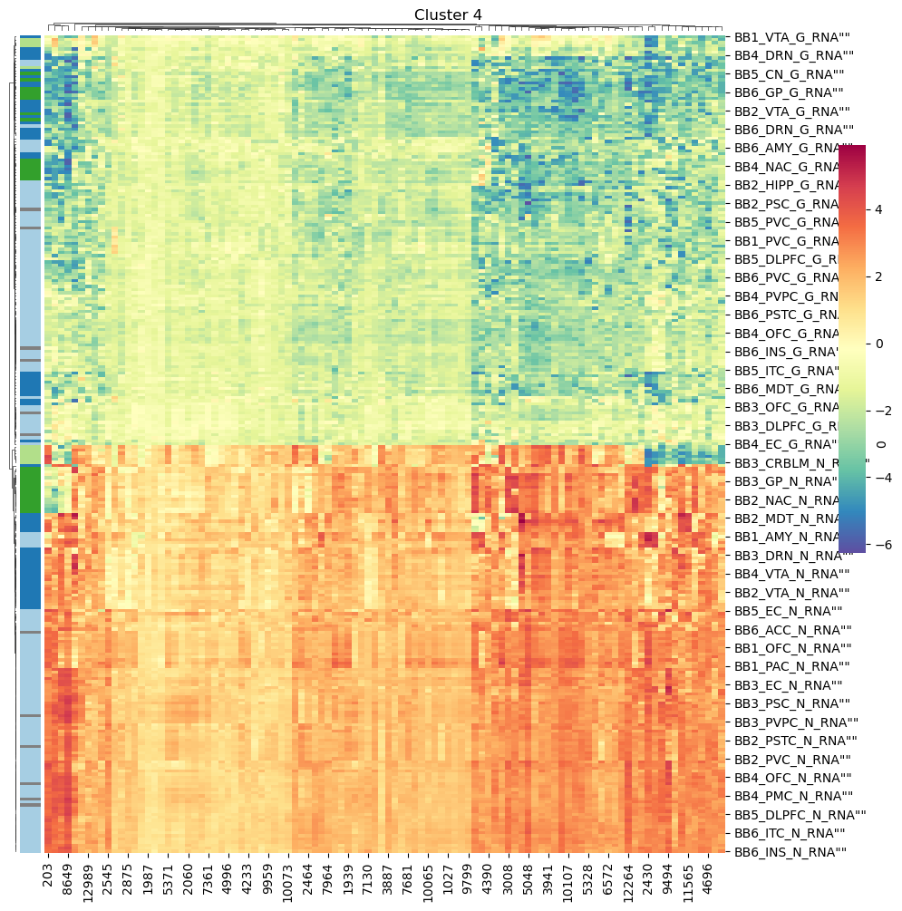
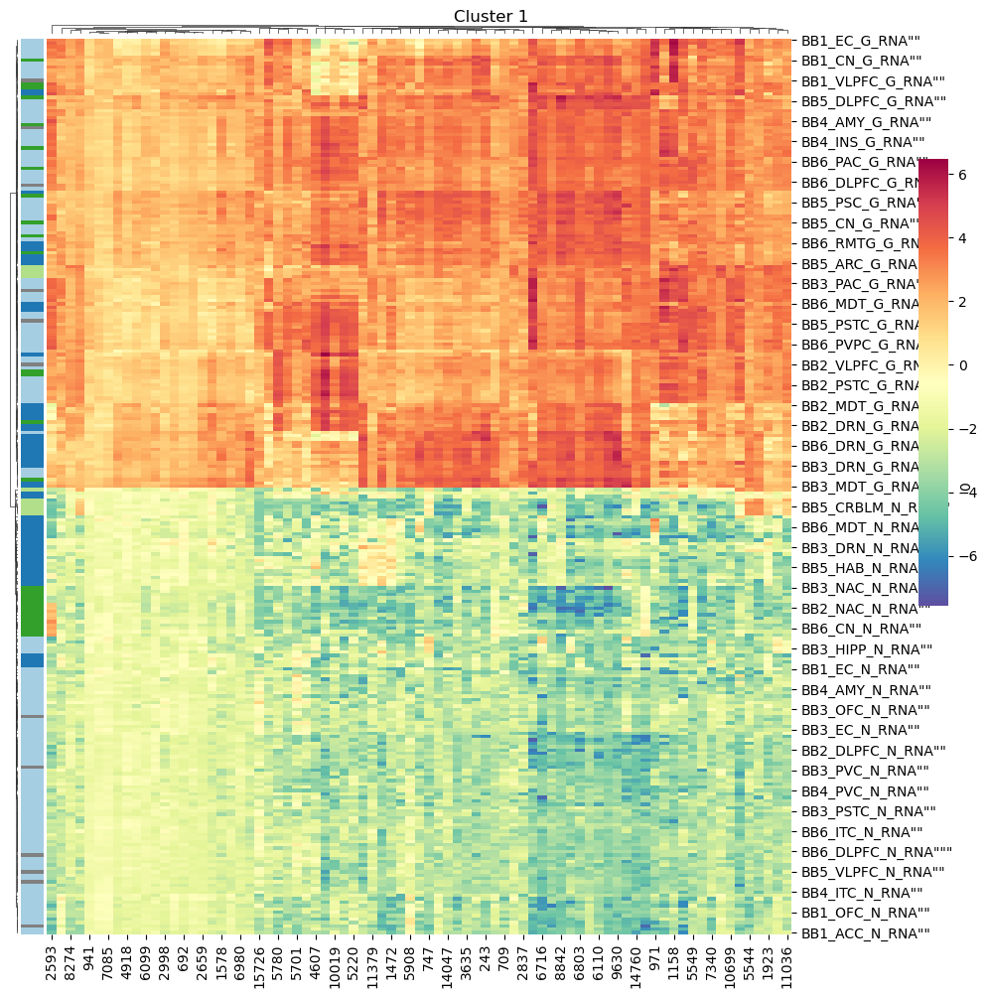
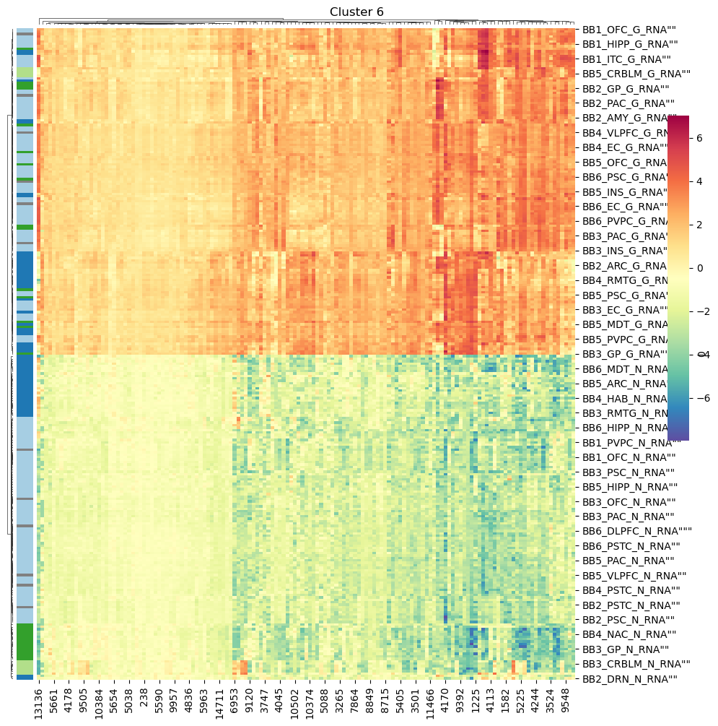
Expression heatmaps for each cluster for K=10
Results
&
Discussion
Notes:
De notar que as amostras do cerebelo permanecem muito juntas.

Slide 43
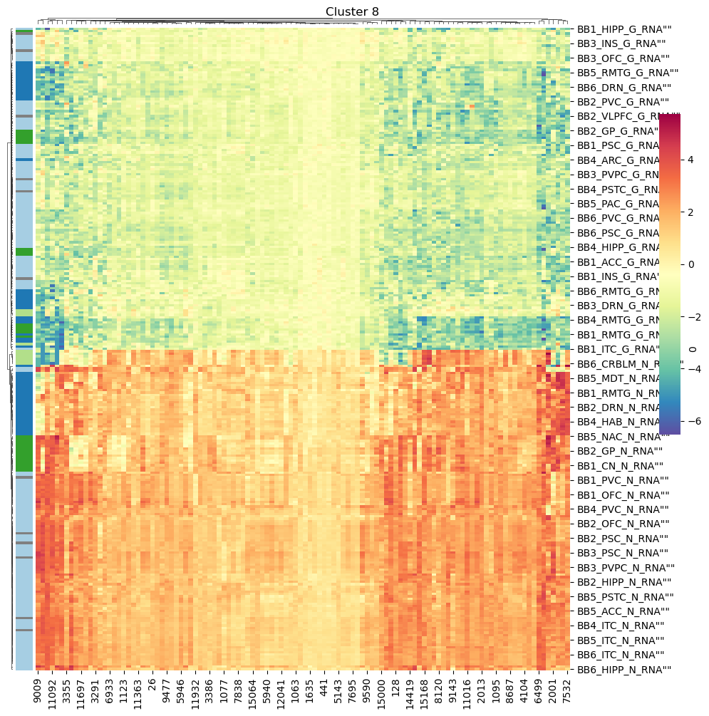
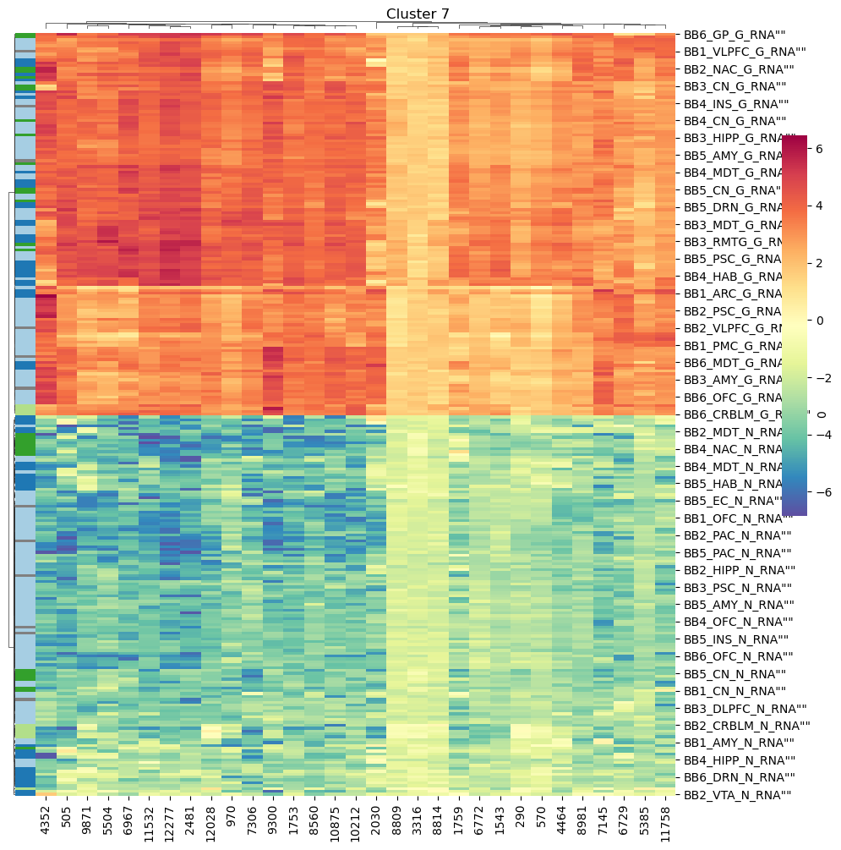
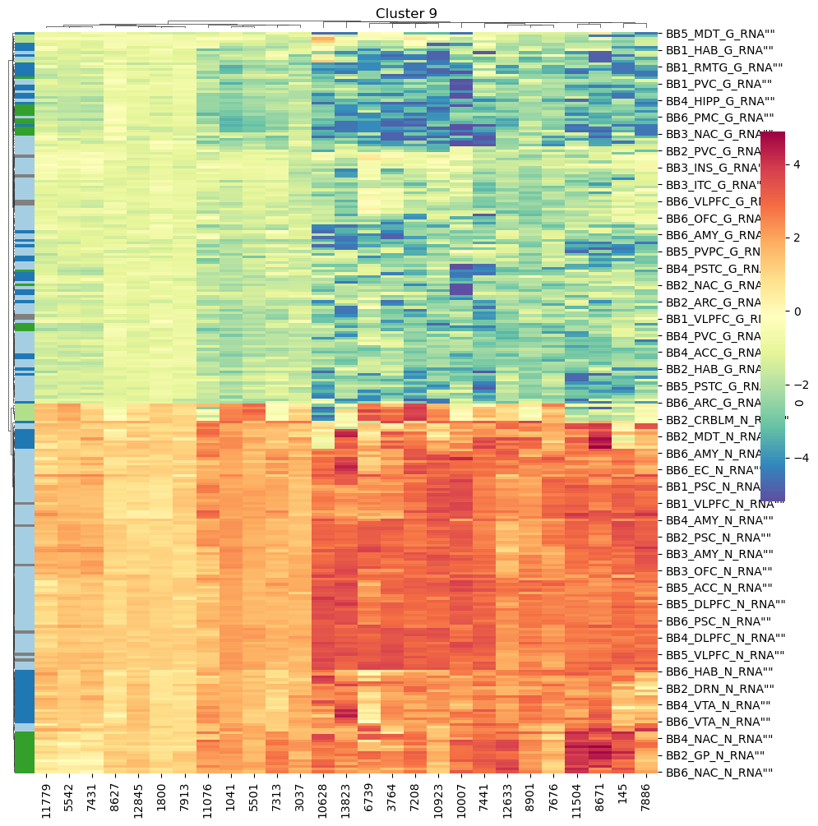
Expression heatmaps for each cluster for K=10
Results
&
Discussion

Slide 44
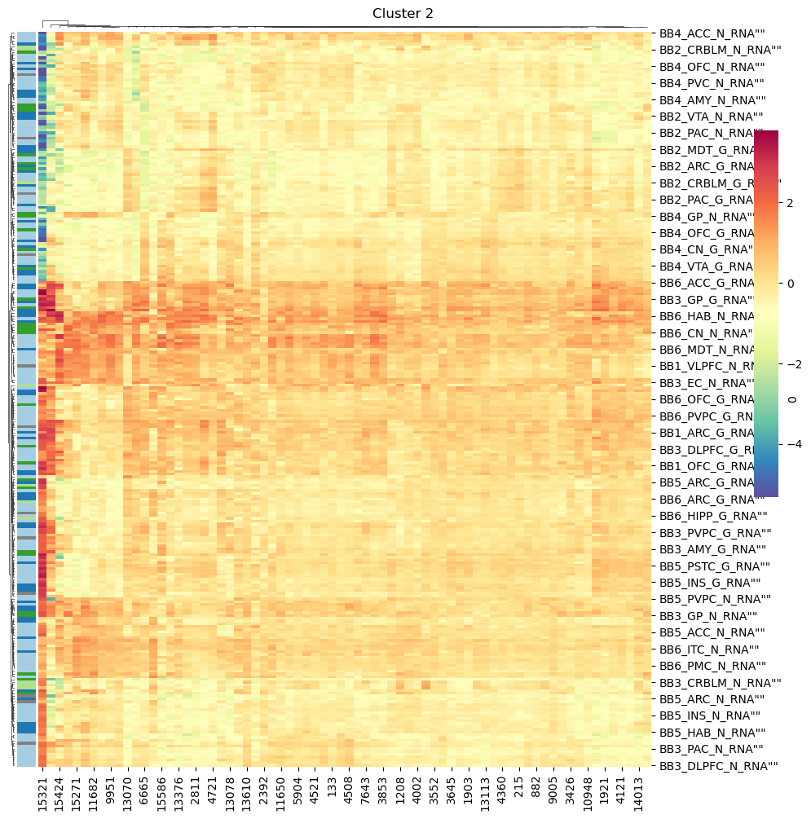
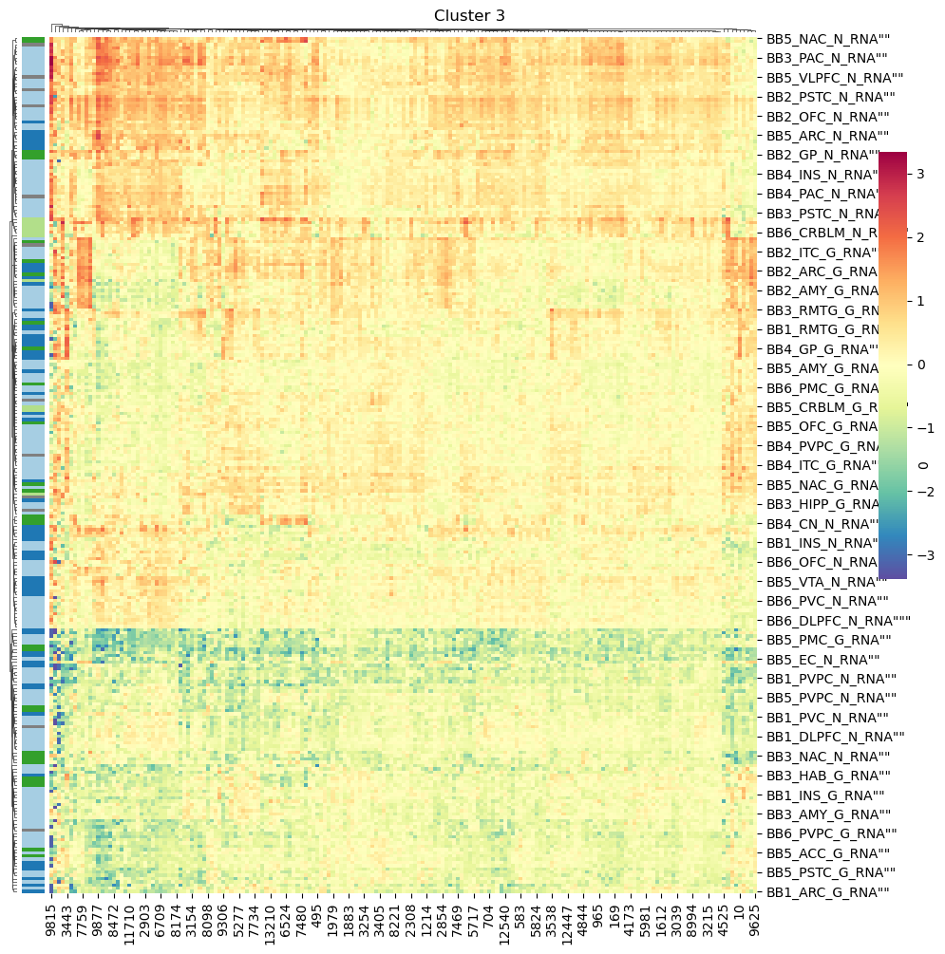
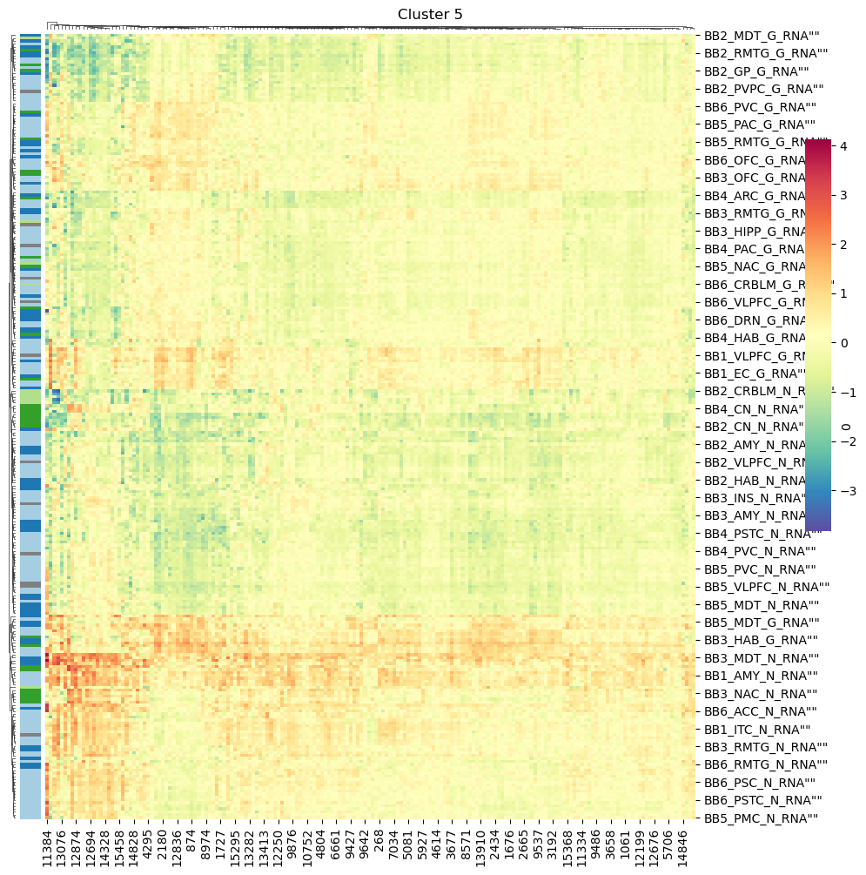

Expression heatmaps for each cluster from K=10
Results
&
Discussion

Slide 45

Future Work and Applications
Conclusions
Gene Set Enrichment Analysis (GSEA)
to inspect if GENE ONTOLOGY did not work
t-Distributed Stochastic Neighbor Embedding (t-SNE)
to reduce dimensionality of data
Gene Coexpression Network Analysis
Multimodal Data Integration
to integrate different data sources to understand the relationships between gene expression and brain structure.
to validate the results
Real-time PCR assays
to reveal strongly related gene modules that play specific roles in brain regions.

Slide 46
Bibliography
C Romero, J. Werme, P. R. Jansen, J. Gelernter, M. B. Stein, D. Levey, R. Polimanti, C. de Leeuw, D. Posthuma, M. Nagel, S. van der Sluis(2022). Exploring the genetic overlap between 12 psychiatric disorders. https://doi.org/10.1101/2022.04.12.22273763
D. Patrik, “How does gene expression clustering work ?,” Nat. Biotechnol., vol. 23, no. 12, pp. 1499–1501, 2005.
Agapito, G., Milano, M., & Cannataro, M. (2022). A Python Clustering Analysis Protocol of Genes Expression Data Sets. Genes, 13(10). https://doi.org/10.3390/genes13101839
Mathur, R., Rotroff, D., Ma, J. et al. Gene set analysis methods: a systematic comparison. BioData Mining 11, 8 (2018). https://doi.org/10.1186/s13040-018-0166-8
Li W, Cerise JE, Yang Y, Han H. Application of t-SNE to human genetic data. J Bioinform Comput Biol(2017) doi: 10.1142/S0219720017500172. Epub 2017 Jun 23. PMID: 28718343.
Lancour, D., Dupuis, J., Mayeux, R. et al. Analysis of brain region-specific co-expression networks reveals clustering of established and novel genes associated with Alzheimer disease. Alz Res Therapy 12, 103 (2020). https://doi.org/10.1186/s13195-020-00674-7
Steyaert, S., Qiu, Y.L., Zheng, Y. et al. Multimodal deep learning to predict prognosis in adult and pediatric brain tumors. Commun Med 3, 44 (2023). https://doi.org/10.1038/s43856-023-00276-y

